Slide 1

NJSC “L. N. Gumilyov National University” Institute of Digital Sciences and Artificial Intelligence Department on Information System
Diploma thesis
6B06103 – “Information System” educational program
Development of a recommendation system for museum exhibits
Done by: B057-6103-22-02 group student Inkara Suleimenova Almazovna
Scientific Supervisor: La. Lira Lvovna

Slide 2
Problem Statement
The relevance of this research is driven by the need to improve user experience in museum environments. Modern museums contain a large number of exhibits, which leads to the phenomenon of museum fatigue - physical and cognitive exhaustion experienced by visitors. As a result, user engagement decreases, and many exhibits remain unnoticed. In this context, the development of intelligent recommendation systems has both practical and theoretical significance, as it enables personalized interaction with art and enhances the overall perception of cultural content.
Symptoms of museum fatigue
Heaviness in the legs
Сognitive freeze
Art blindness
The urge to escape
Scheme 1. Symptoms of museum fatigue

Slide 3
Objective
The objective of this thesis is to develop a recommendation system that personalizes museum exhibit suggestions, increases user engagement, and simplifies interaction with art.

Slide 4
Thesis Tasks
Сollection, analysis, and systematization of scientific and technical literature on recommendation systems and digital museum technologies;
Selection of appropriate methods for image processing, feature extraction, and recommendation generation;
Development and implementation of a recommendation algorithm based on visual similarity and user preferences
Design of system architecture, including backend, database, and user interface;
Evaluation of system performance and formulation of conclusions.

Slide 5
Literature Review
Authors | Approach | Domain | Key Idea
Zavattaro et al. (2026) | Behaivoral analysis | Museums | Museum fatigue
Casillo et al. (2025) | Context-aware RS | Culture | Personalization
Kim (2024) | Content-based | Art | User preferences
Yilma et al. (2025) | Visual RS | Art | Interactive system
Radford et al. (2021) | CLIP | AI | Image embeddings
Steck et al. (2024) | Similarity metrics | ML | Cosine similarity analysis
Table 1. Comparative Analysis of Literary Sources

Slide 6
Comparative Analysis of Competitors
Criteria | Google Arts & Culture | Smartify | Metropolitan Museum of Art | Rijksmuseum
System Type | Web platform | Mobile application | Museum website | Museum website
Main Function | Collection browsing, virtual tours | Artwork recognition | Online collection | Online collection
Personalization | Limited | Minimal | None / weak | Limited
Recommendation Systems | Basic (similar artworks) | Almost none | None | Partial (category-based)
Use of AI | Partial | Yes (image recognition) | Minimal | Minimal
Interest-based Navigation | Limited | None | None | Limited
User Collection Creation | Yes | No | Yes | Yes
Main Limitation | Lack of deep personalization | Lack of recommendation features | Lack of personalization | Lack of AI-based recommendations
Table 2. Comparative analysis of the systems

Slide 7
Dataset Selection
Analysis of available data sources
Source | Type | Advantages | Limitations | Conclusion
Rijksmuseum API / Metropolitan Museum of Art API | Online APIs | • Large-scale art collections • Official museum data • Rich metadata (artist, period, technique, etc.) | • Complex API integration • Requires data parsing and preprocessing • High preprocessing effort | Suitable for research-oriented projects, but too complex for an ML pipeline
Kaggle Rijksmuseum dataset | Ready-made dataset | • Easy access • Pre-structured data • Fast to use for initial experiment | • Limited number of classes (4) • Low image diversity • Limited generalization ability | Suitable for baseline experiments, but not for robust models
WikiArt dataset (final choice) | Ready-made dataset | • High diversity of artistic styles • Rich art categories • Suitable for visual analysis and ML tasks • Better balance across styles | • Noisy metadata possible • Requires data cleaning | Optimal choice for the project (final dataset)
Table 3. Comparative analysis of the datasets

Slide 8
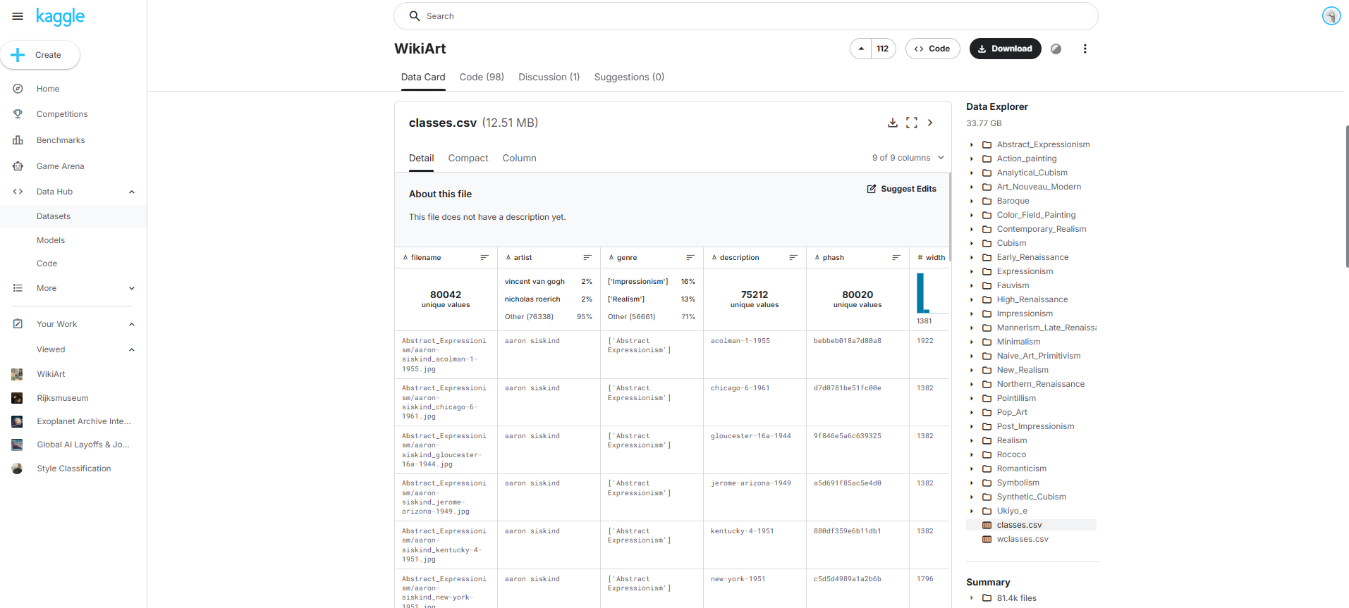
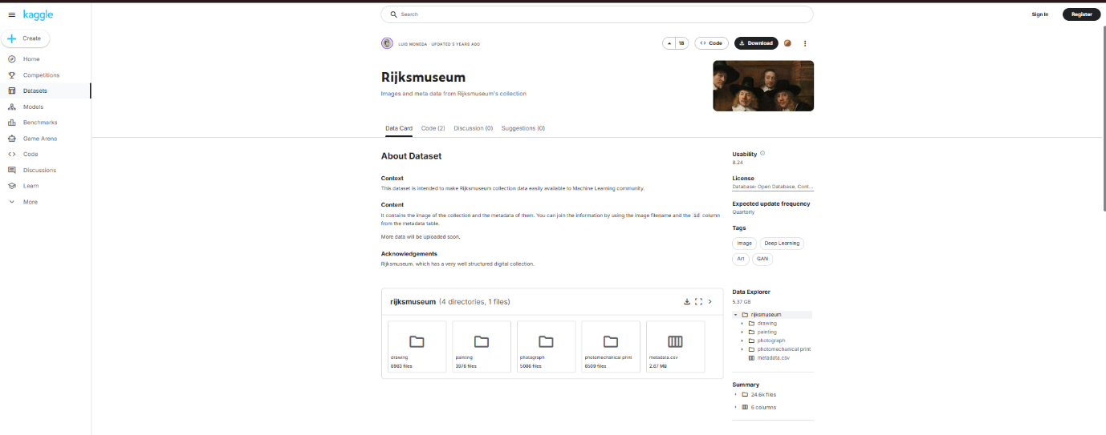
Dataset Selection
Figure 1. Rijksmuseum Dataset in Kaggle
Figure 2. WikiArt Dataset in Kaggle

Slide 9
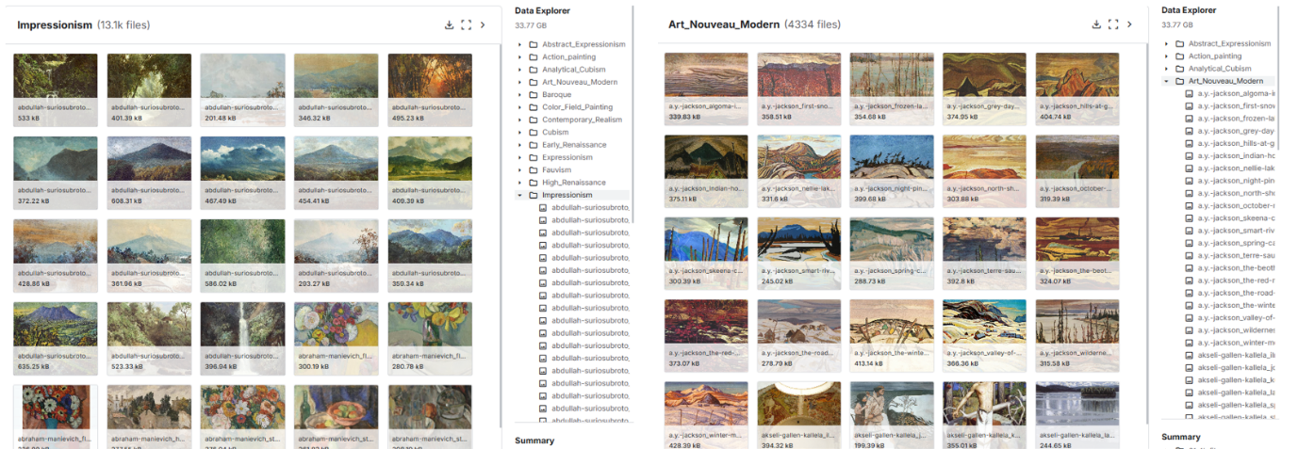
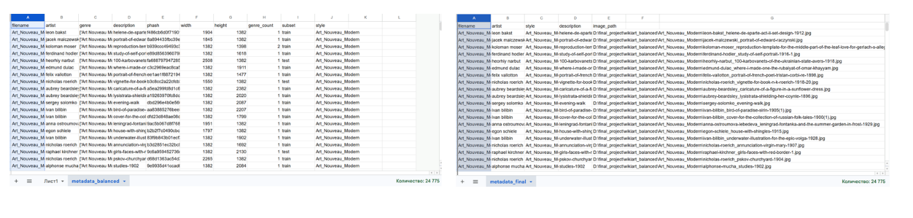
Data Prerocessing
Problems:
Large dataset size (~30 GB)
Class imbalance problem
Solutions :
Figure 3. Imbalance classes
Dataset balancing
~2000 images per style
Custom script: build_balanced_dataset.py
Output: metadata_final.csv
Figure 4. Result of preprocesing

Slide 10
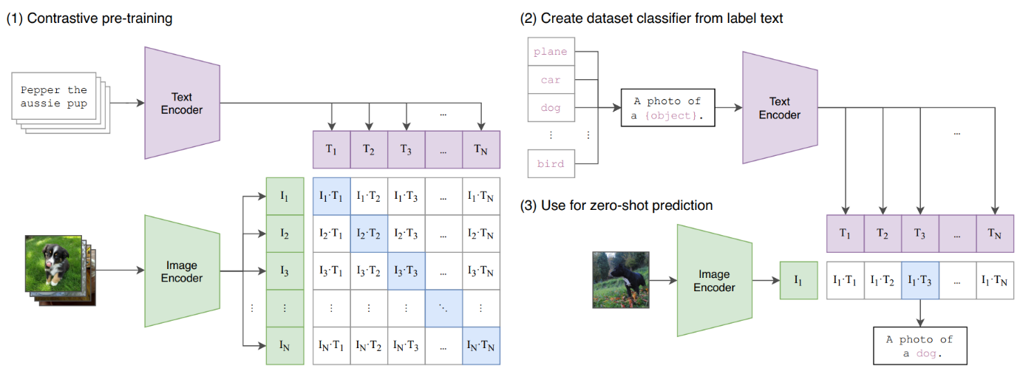
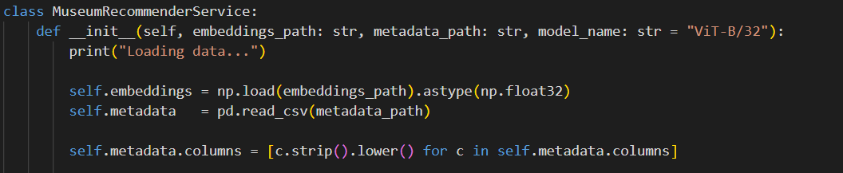
Image Embeddings
CLIP (Contrastive Language–Image Pretraining) is a multimodal AI model developed by OpenAI. It learns a shared embedding space for images and text. In this system CLIP converts artworks (images) into vector embeddings.
Embeddings – vectors that represent the images and their features visually and semantically. They are numeric vectors of a certain size and include information about the images that are fed into the system.
Figure 5. Visualization of CLIP model
Figure 6. Type of CLIP model

Slide 11
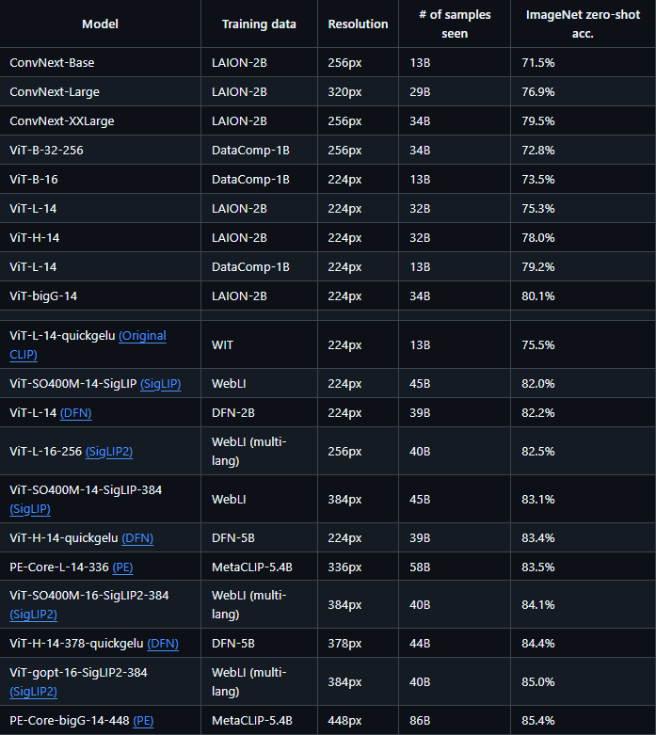
CLIP Models
Figure 7. Comparative analysis of the CLIP models from GitHub

Slide 12
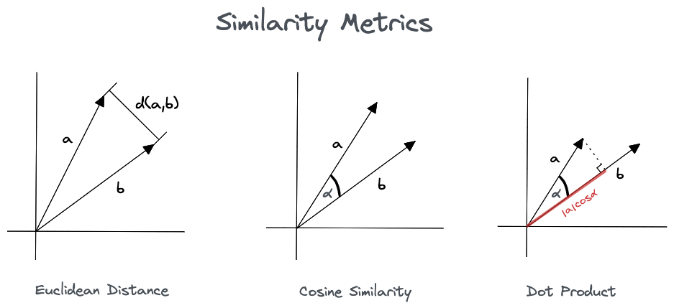
Cosine Similarity
Cosine similarity is a metric used to measure how similar two vectors are by calculating the cosine of the angle between them in a multidimensional space.
Cosine similarity was chosen over Euclidean and Manhattan distances due to its ability to measure angular similarity in high-dimensional embedding space, making it more suitable for CLIP-based semantic representations of artworks
Cosine similarity was selected as the main metric for the recommendation system. It measures the semantic closeness between CLIP embeddings of artworks. The system recommends paintings based on similarity between artworks themselves, not on user behavior or interactions.
Figure 8. Similarity Metrics

Slide 13
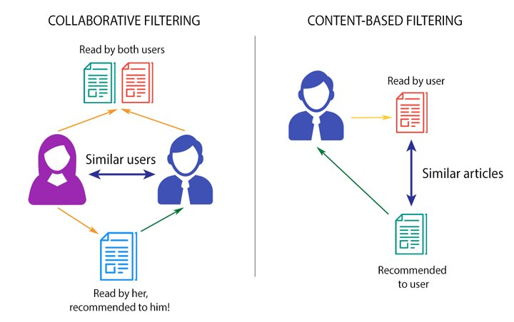
Recommendation System
A recommender system is an AI-driven information filtering tool designed to predict and suggest items - such as products, media, or content - that a user is most likely to want. By analyzing past behavior, preferences, and interactions, these systems help users navigate overwhelming choices while maximizing business engagement and revenue. The developed recommendation system is based on a content-based approach, where recommendations are generated using the visual and semantic features of artworks rather than interactions of other users.
Figure 9. Type of Recommendation System

Slide 14
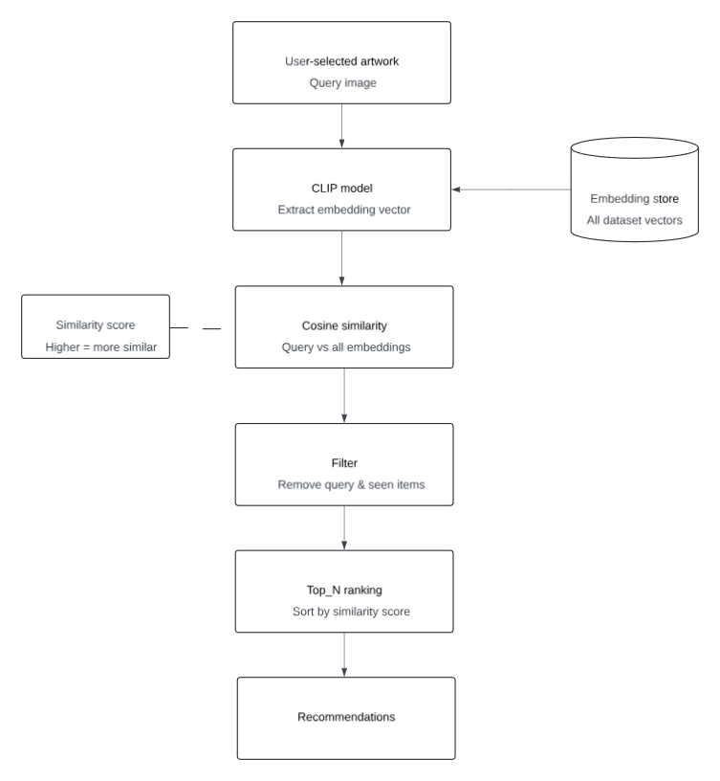
Recommendation Algorithm Scenario 1
The first recommendation scenario is based on finding similar artworks. A selected artwork is treated as a query image Its embedding is compared with embeddings of all artworks in the dataset. Similarity is calculated using cosine similarity in the embedding space Results are ranked in descending order and Top-N most similar artworks are returned. This approach enables users to discover artworks based on visual and semantic similarity, implementing a nearest-neighbor search in the embedding space.
Scheme 2. Scheme of first scenario of recommendation system. Similar Artwork Search

Slide 15
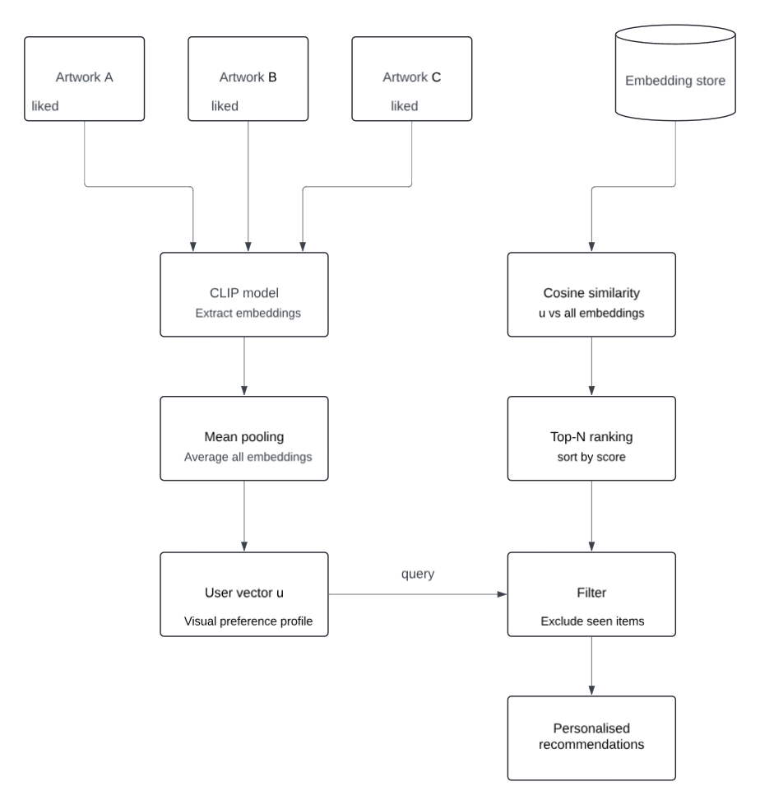
Recommendation Algorithm Scenario 2
The second scenario focuses on personalized recommendations based on user preferences. A user preference vector is created by averaging embeddings of all liked artworks. This vector represents the user’s overall visual and semantic taste profile. Recommendations are generated by computing cosine similarity between the user vector and all artwork embeddings. The system returns Top-N most relevant artworks based on similarity scores
Scheme 3. Scheme of second scenario of recommendation system. Personalized Recommendations

Slide 16
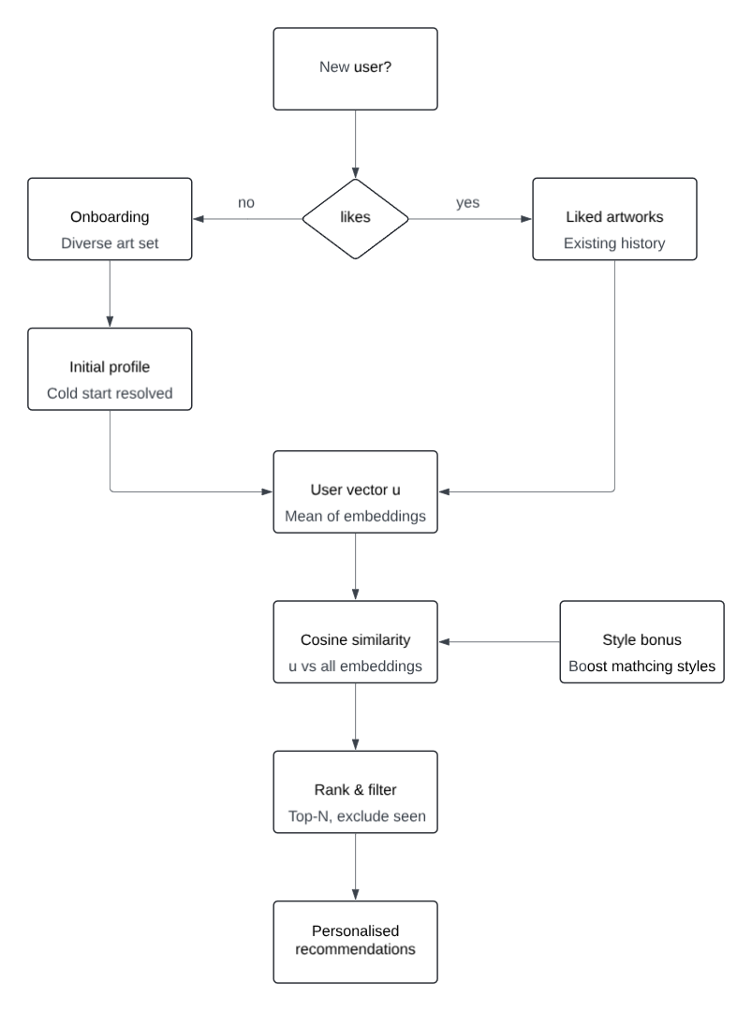
Onboarding & Cold-Start Solution
The system addresses the cold-start problem, where no user interaction history is available at the beginning. An onboarding stage is used to collect initial user preferences. Users are shown a representative set of artworks across different styles. Based on user selections, an initial preference profile is constructed. A style bonus coefficient is applied to emphasize artworks matching preferred styles Already seen artworks are filtered out to ensure diversity and avoid repetition
Scheme 4. Scheme of Onboarding

Slide 17
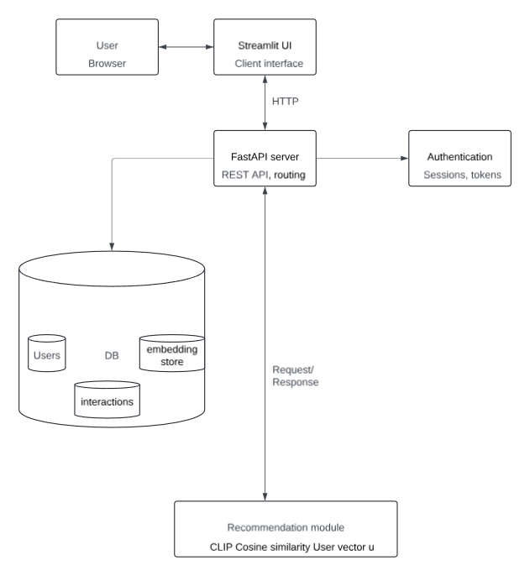




Technology stack and architecture
Frontend
Streamlit - interactive web interface • rapid UI development for ML applications • easy visualization of results and embeddings • user-friendly dashboard for recommendations
Backend
Python - core development language
FastAPI - high-performance API framework • handles requests for recommendations and model inference
CLIP (OpenAI) - multimodal embedding model • extracts semantic features from images and text • enables similarity-based recommendation of artworks
Database
PostgreSQL - relational database • stores artwork metadata, embeddings, and user interactions • scalable and suitable for complex queries
Scheme 5. Scheme of system’s multi-tier client-server architecture

Slide 18
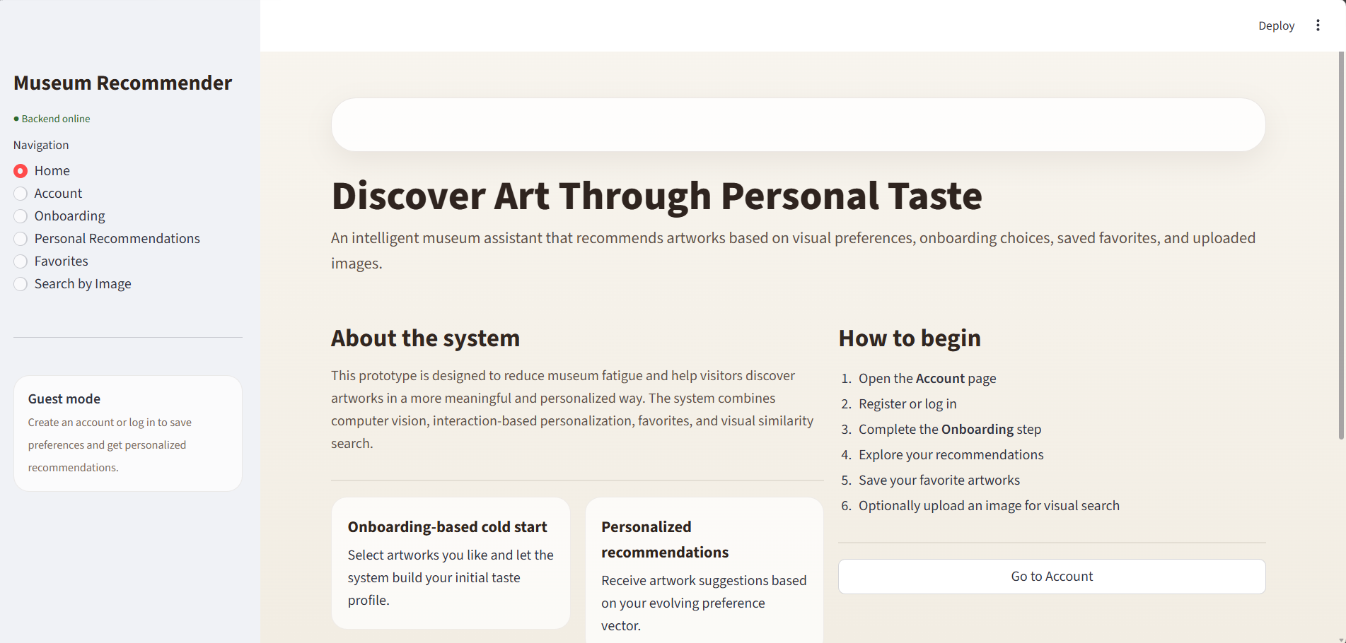
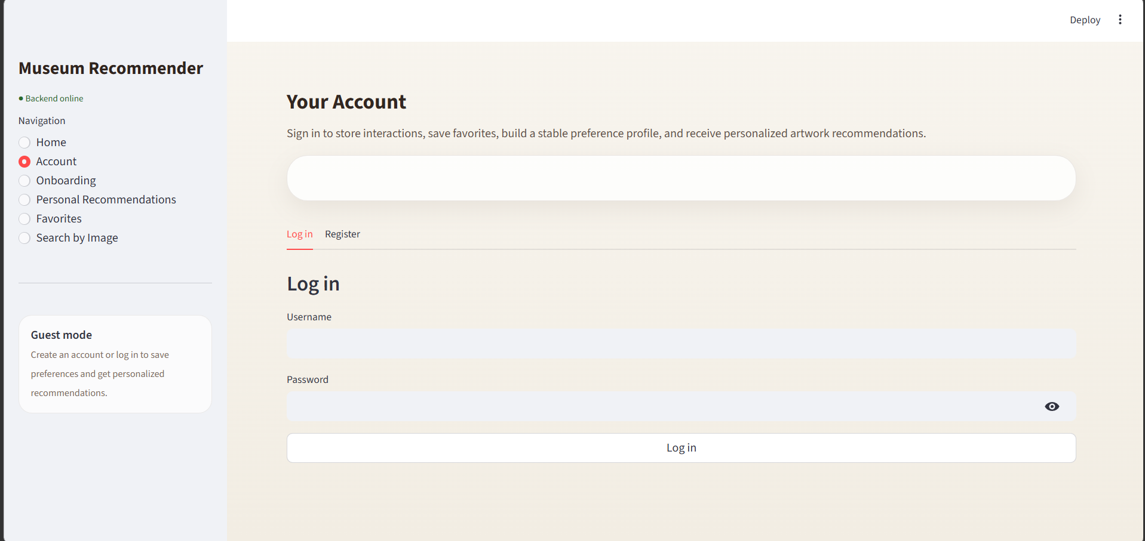
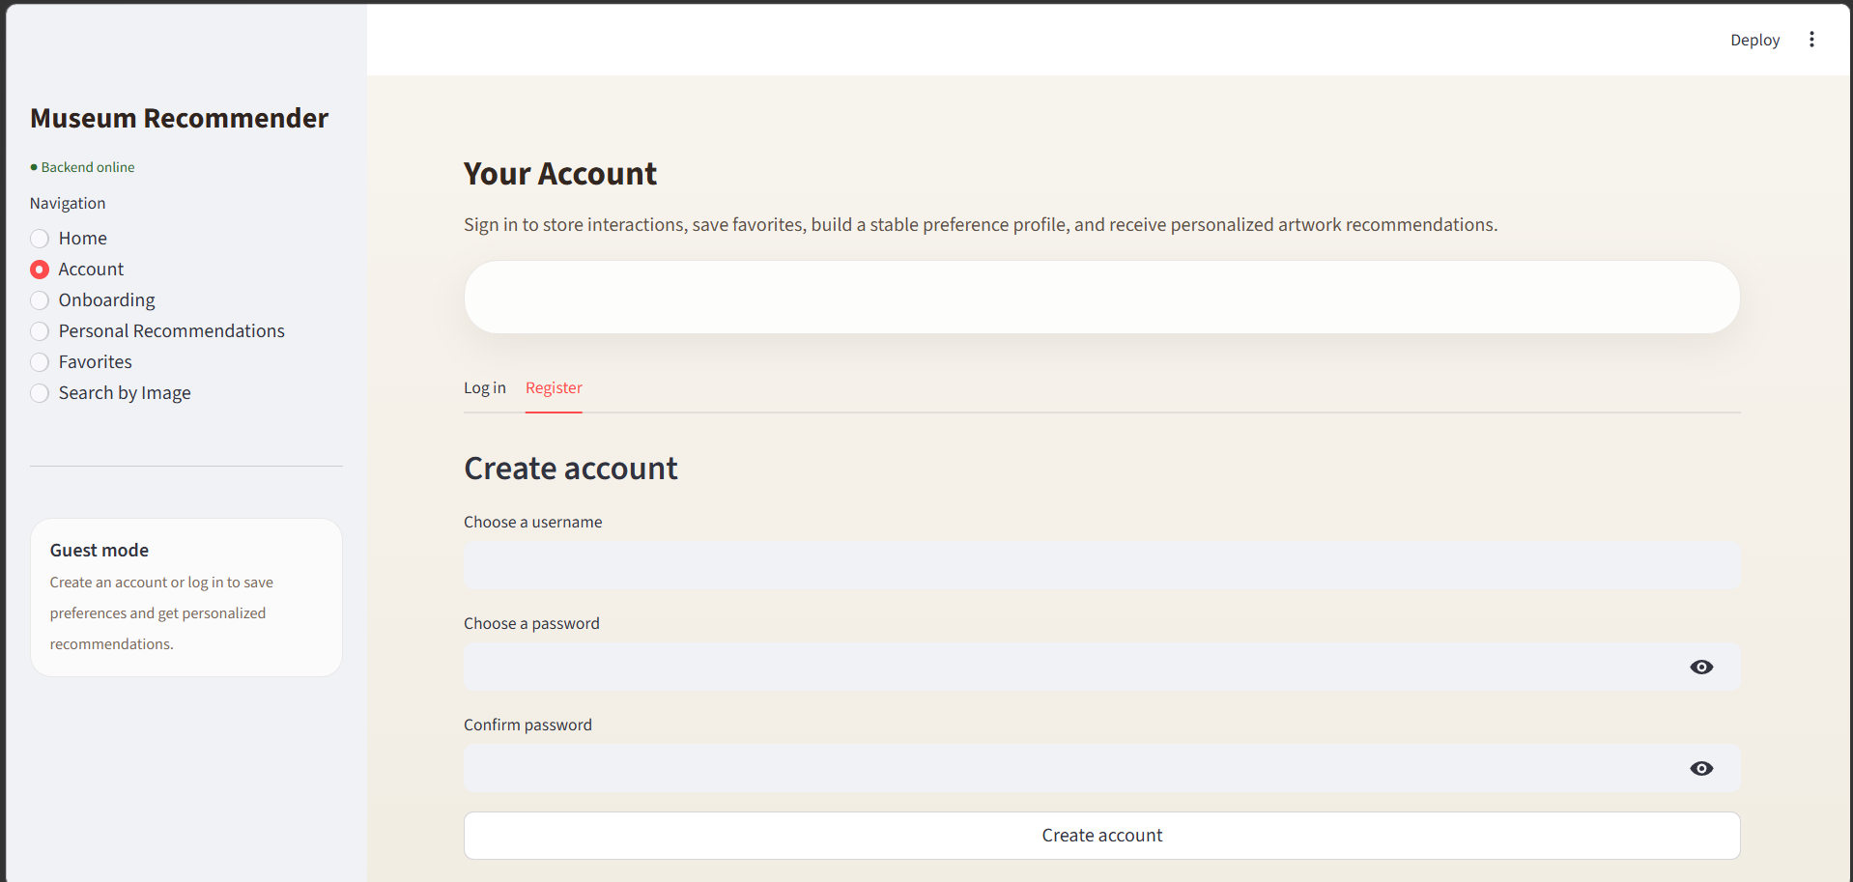
System Demonstration
Figure 10. Home Page
Figure 11. Account – Log In
Figure 13. Account – Sign In
The initial entry page of the system.
Verifies user identity and grants access to personalized features
Allows existing users to access their personal account.

Slide 19
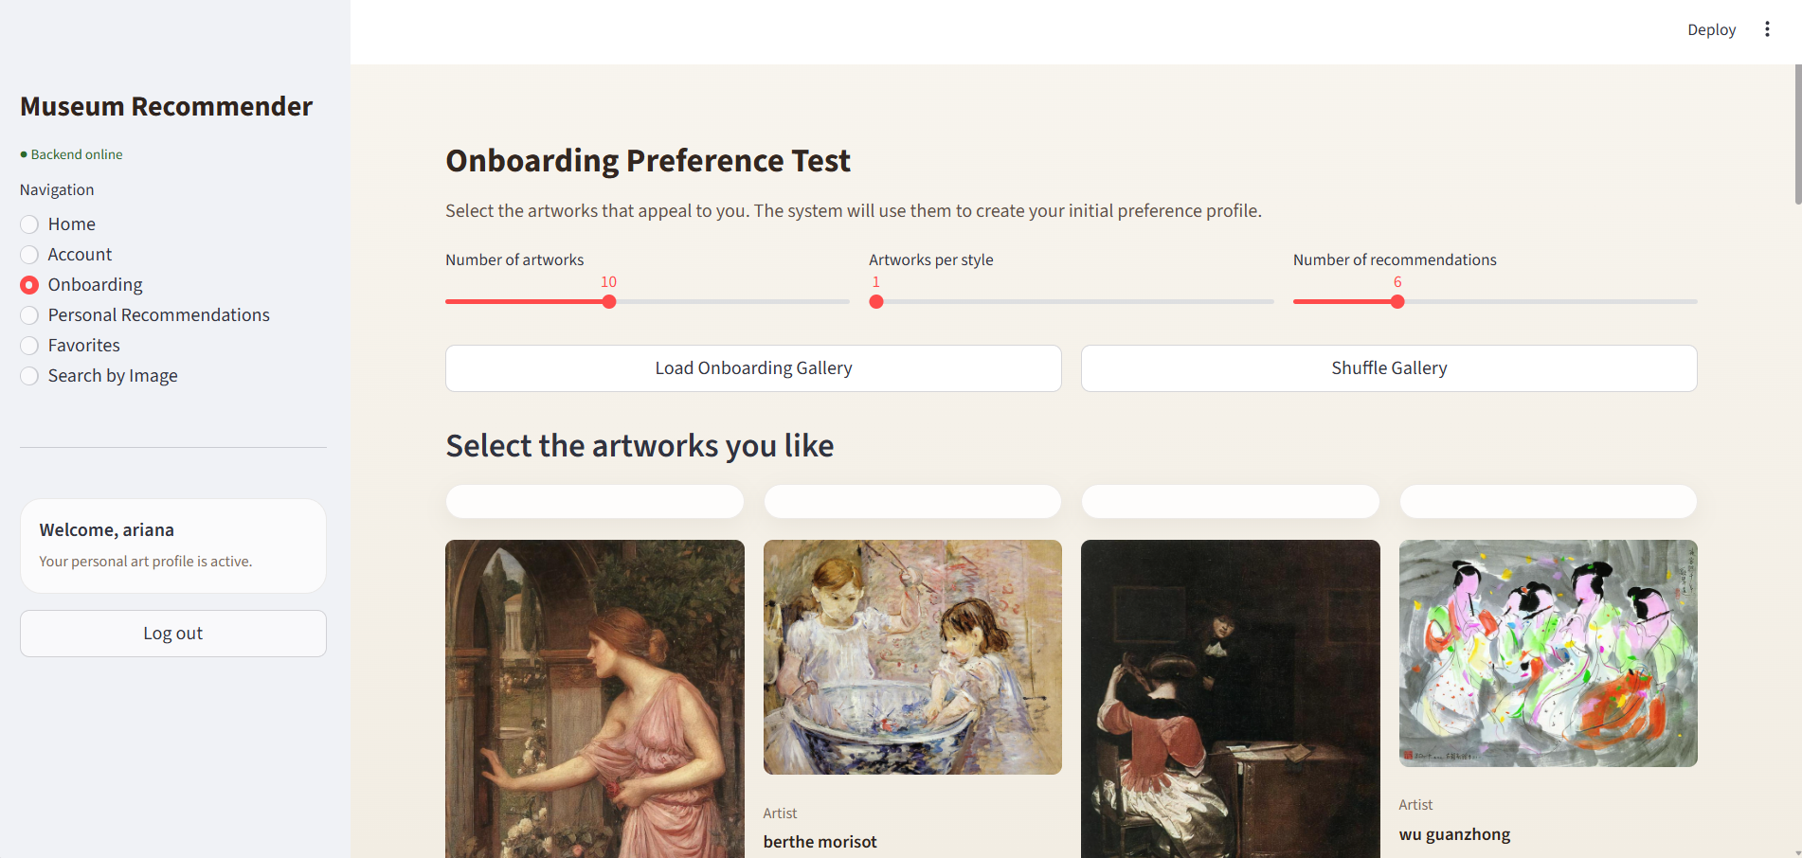
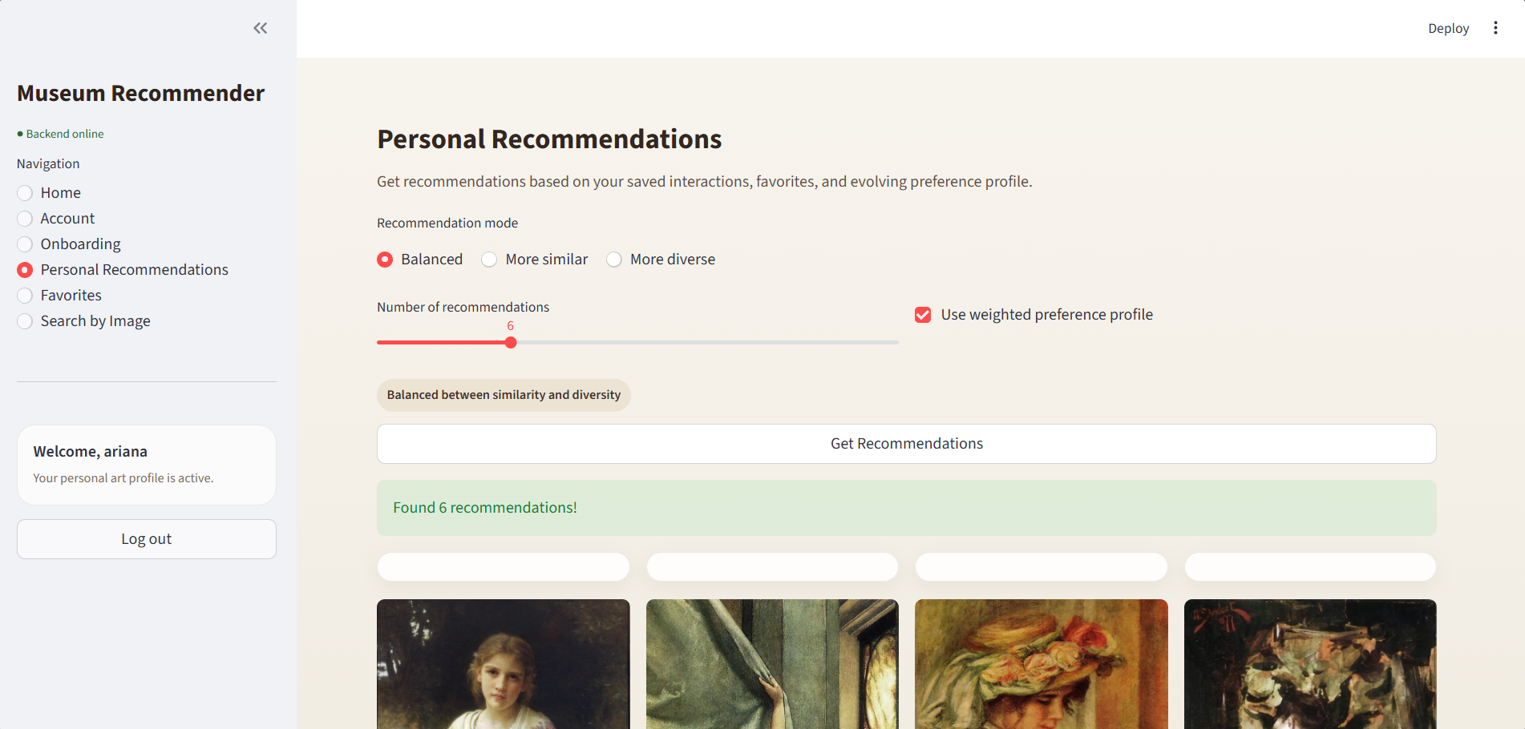
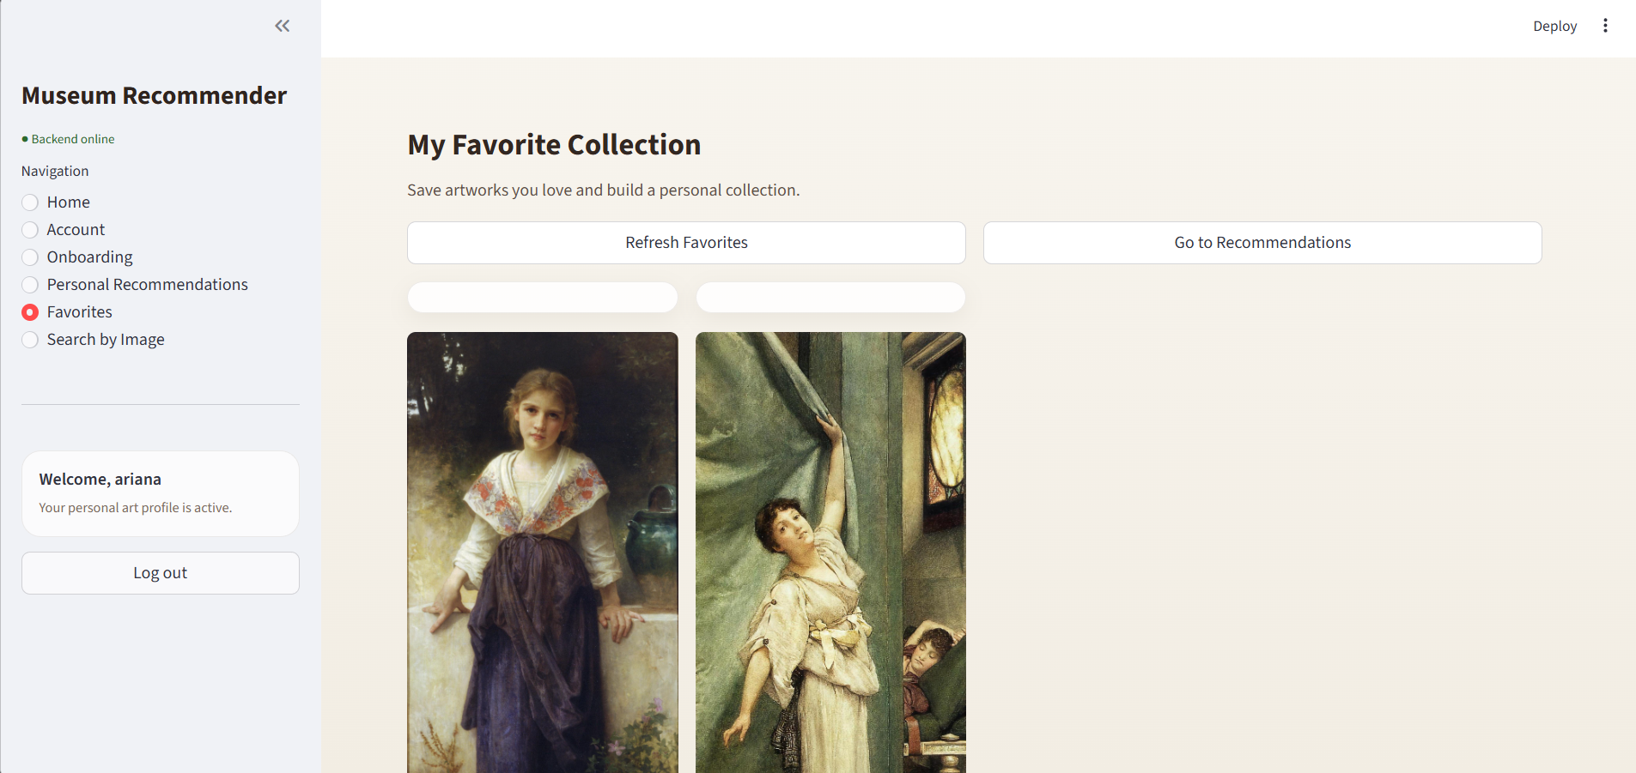
System Demonstration
Onboarding Reference Test
Personal Recommendations
My Favorite Collections
Users are shown a curated set of representative artworks.
Generates recommendations based on user preference vector.
Stores artworks explicitly marked as liked by the user.

Slide 20
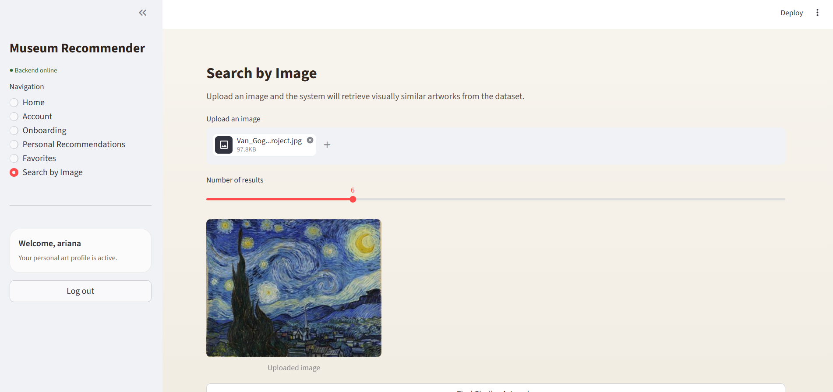
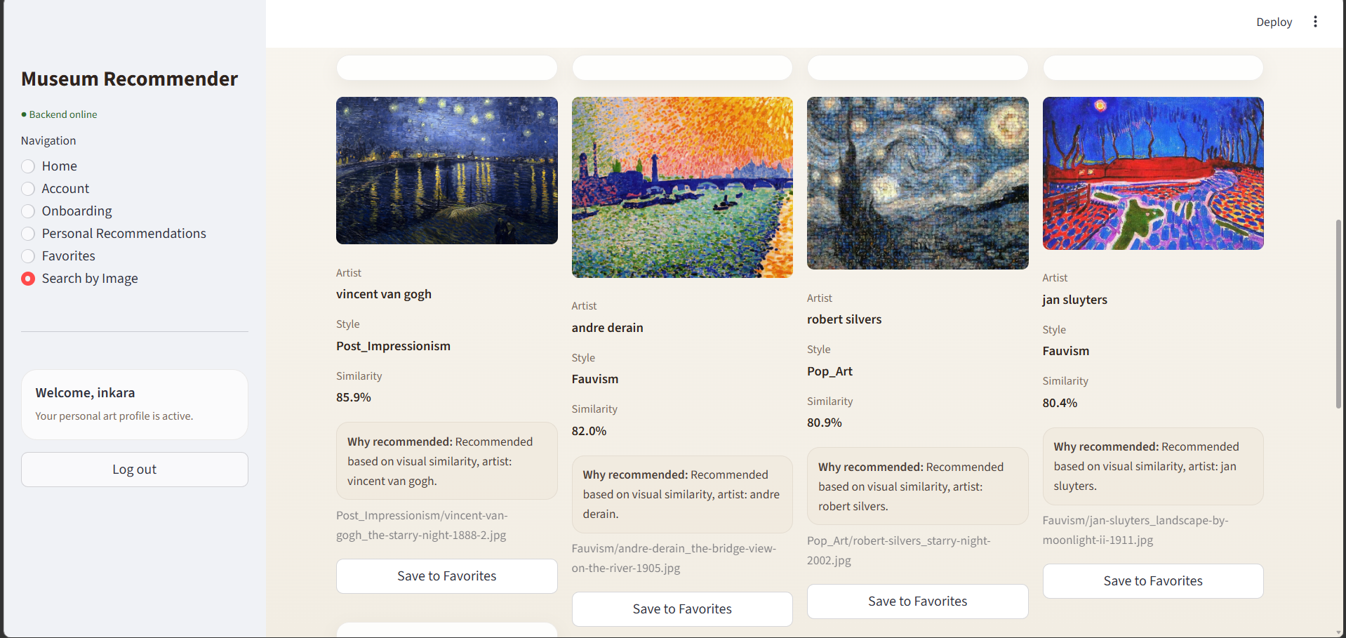
System Demonstration
Search by Image: upload an image
Search by Image Page: result
Allows users to upload an artwork image as a query
The results are displayed to the user as a gallery.

Slide 21
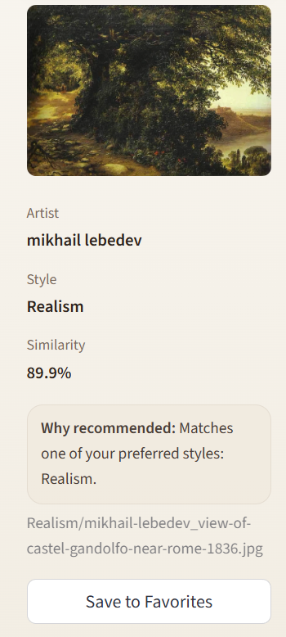
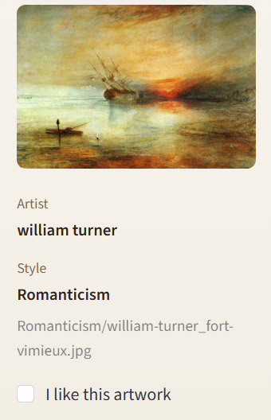
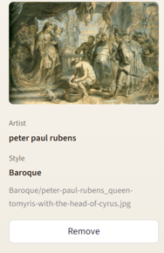
System Demonstration
Onboarding Reference Test
Illustration of Cards
Personal Recommendations
Illustration of Cards
My Favorite Collections Illustration of Cards

Slide 22
Conclusion
A museum recommendation system was successfully developed to improve user experience and enable personalized interaction with cultural content. The system addresses the need for digital transformation and personalization in the museum sector. System provides meaningful and explainable recommendations based on visual similarity. Effectively solves the cold-start problem using onboarding strategy. Demonstrates the effectiveness of AI in cultural and museum applications. The developed system demonstrates the practical value of modern AI techniques in the cultural domain and can serve as a foundation for scalable intelligent museum platforms.

